Slide 1
Affordable NYC Tour
Trong Le
Andrew Preciado
Richard Taggart

Slide 2
Solve:
Explore beautiful places in NYC
Easy tools to control budget
Save lot of $$$$$$ and Still have a good time

Slide 3
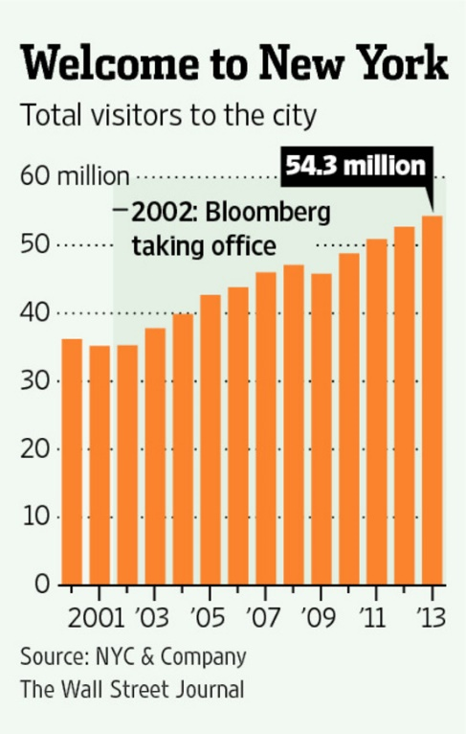
Facts:

Slide 4

Targets
James: College student, age 20
International visitors – low budget
People don’t want to spend more than $120/day in NYC

Slide 5
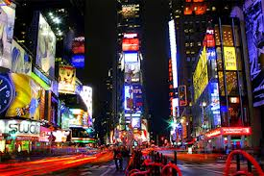
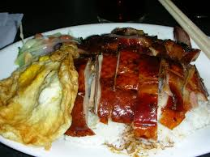
App Features:
Only show little $ or free attractions
Only show cheap but tasty food

Slide 6
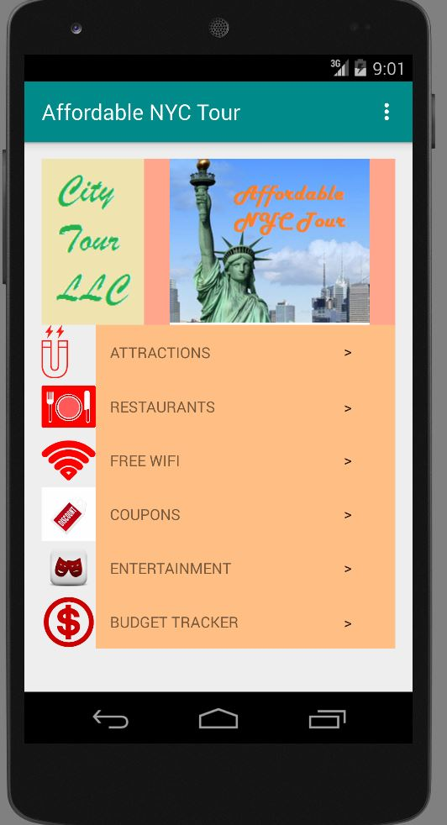

Slide 7
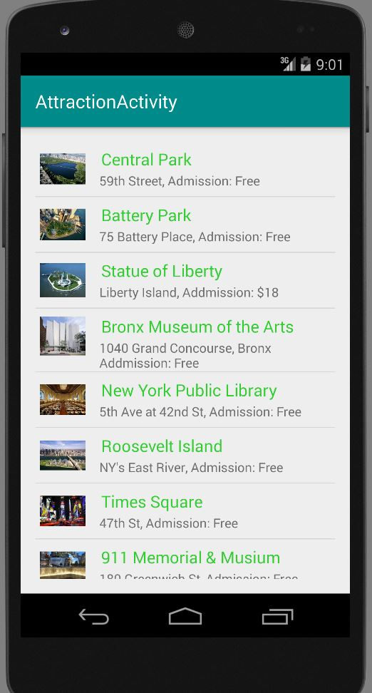

Slide 8
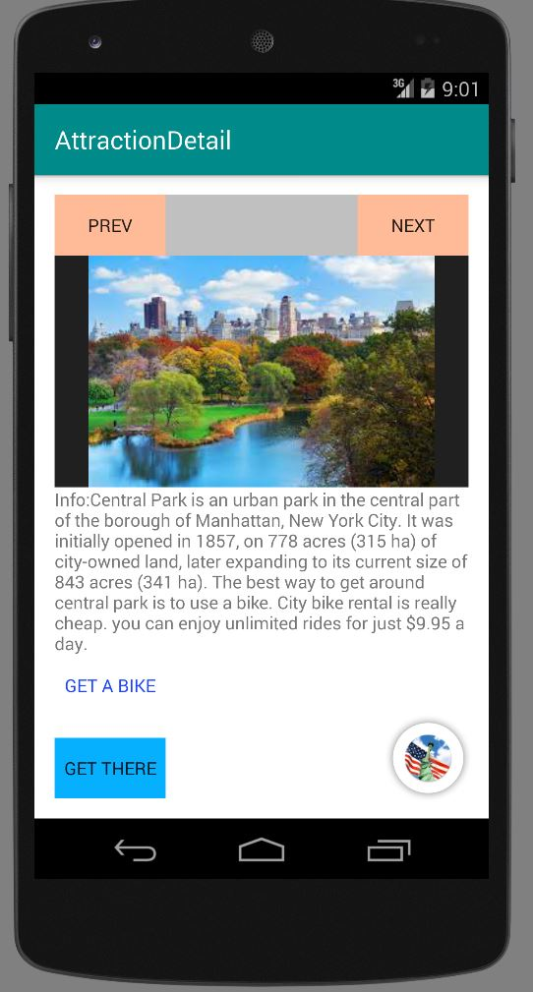

Slide 9
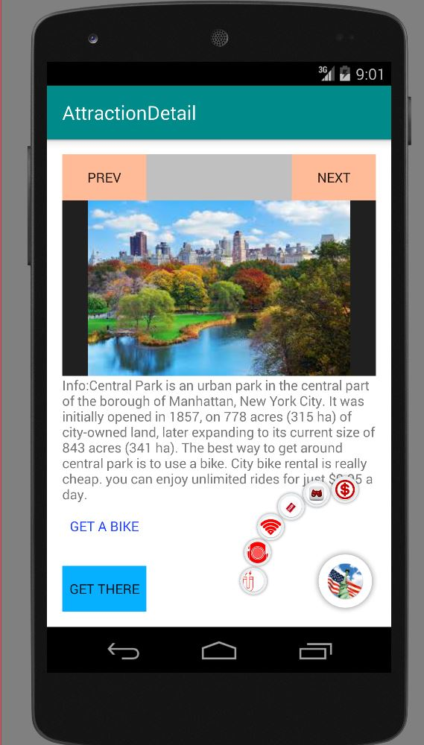

Slide 10
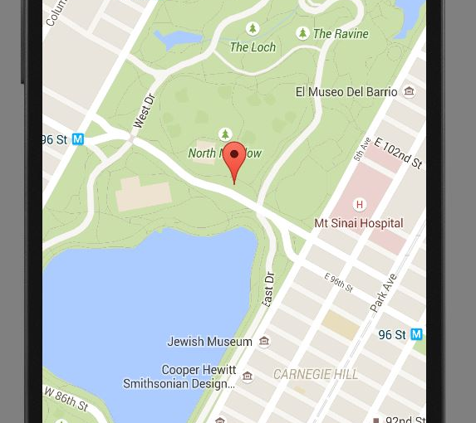

Slide 11
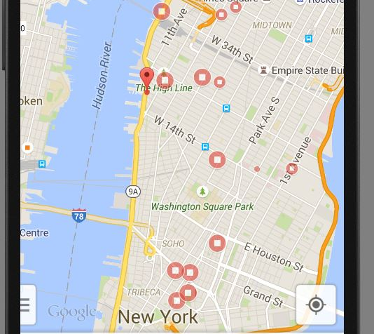

Slide 12
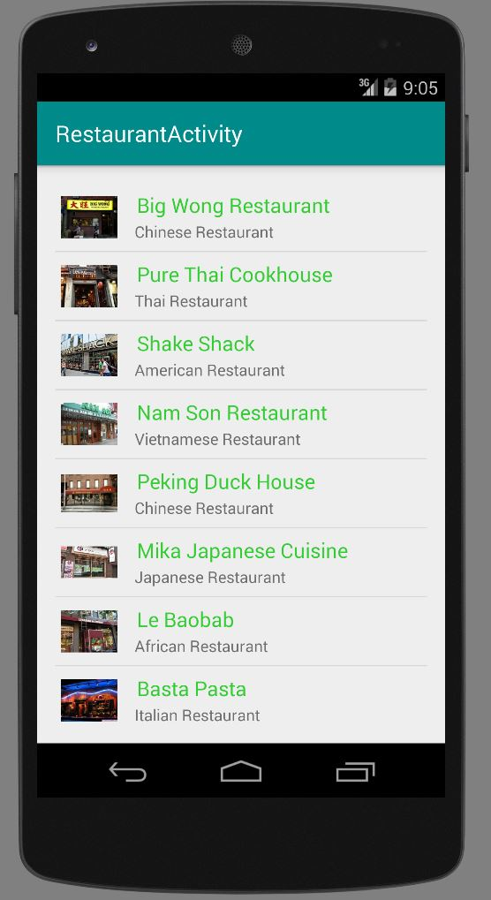

Slide 13
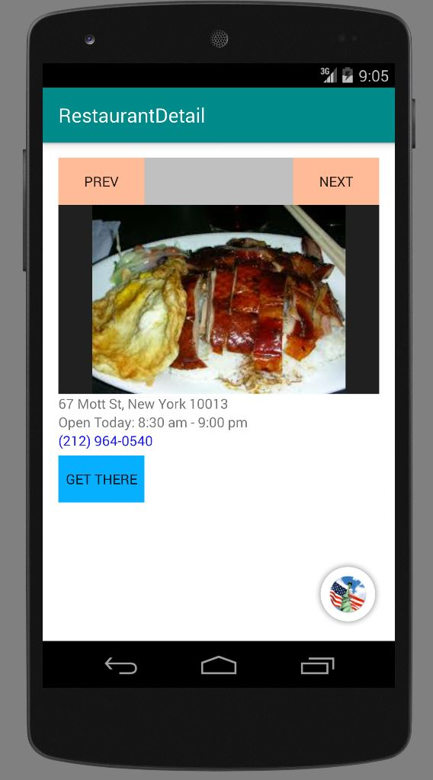

Slide 14
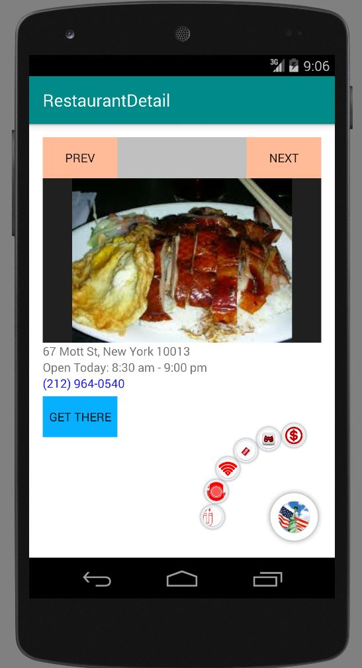

Slide 15
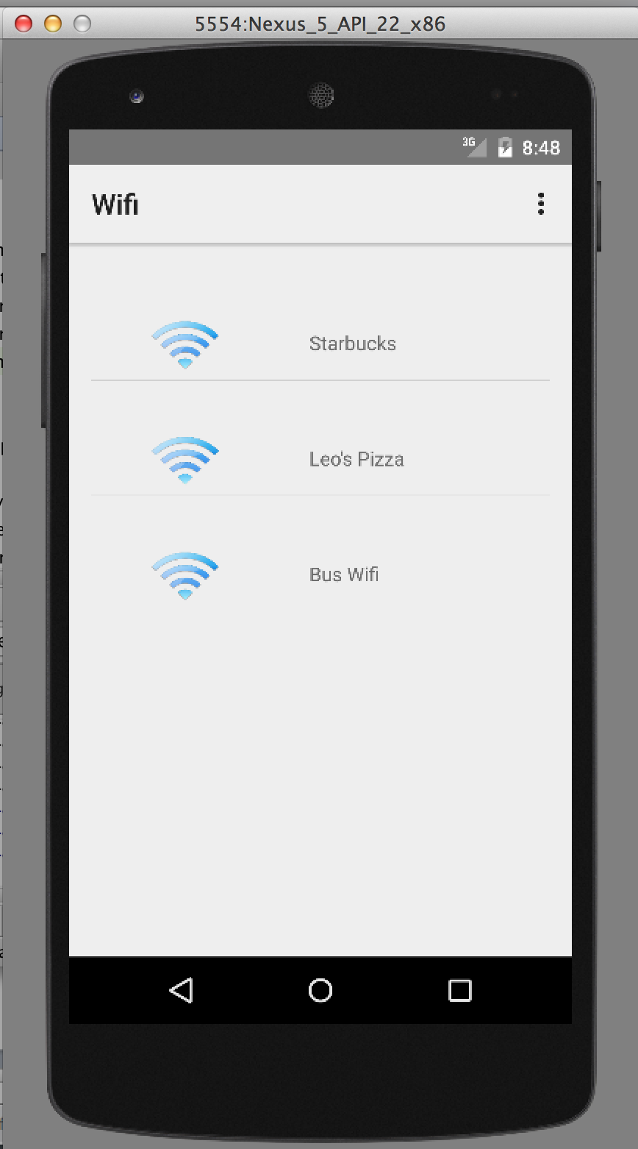

Slide 16
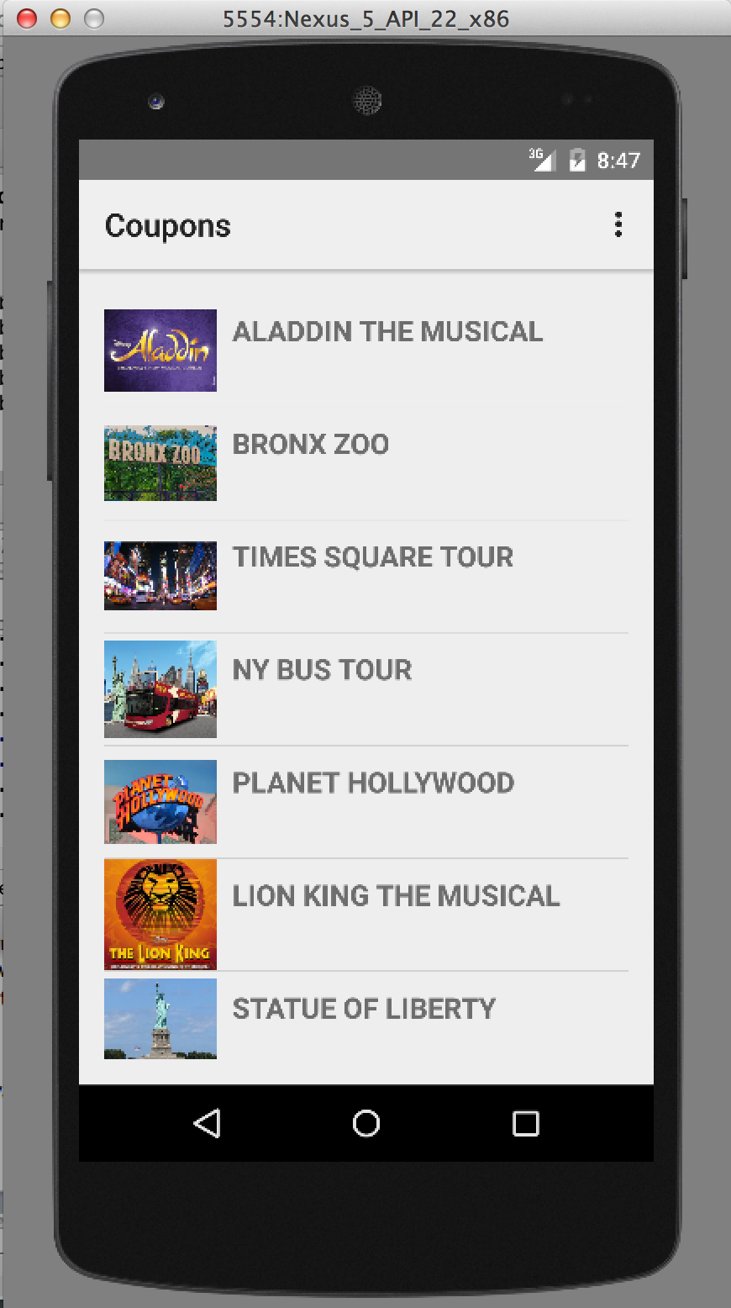

Slide 17
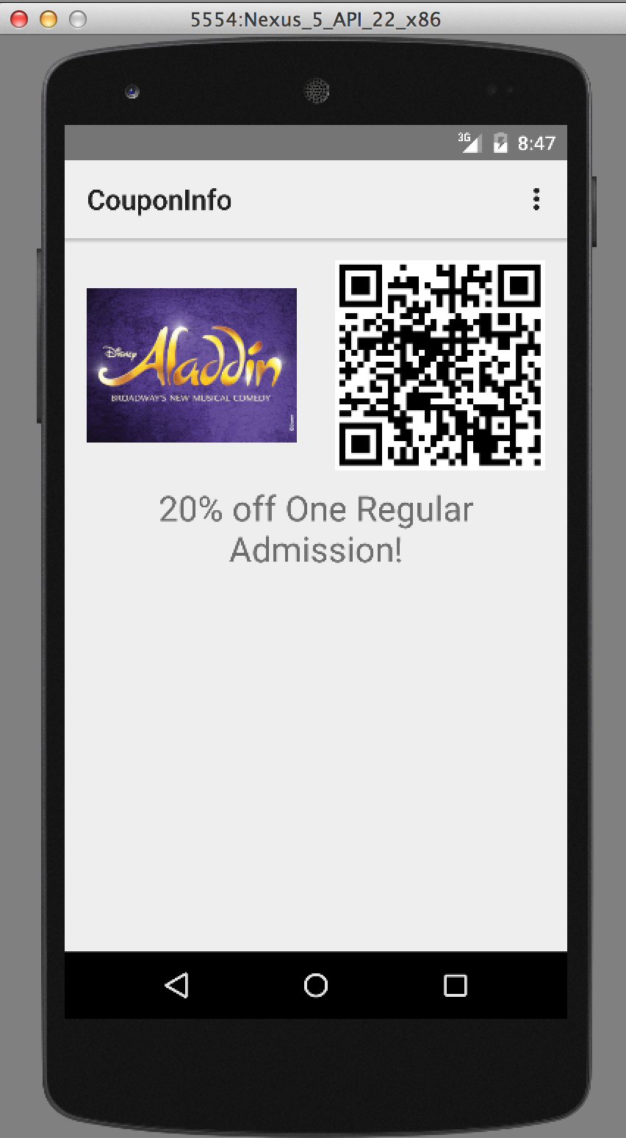

Slide 18
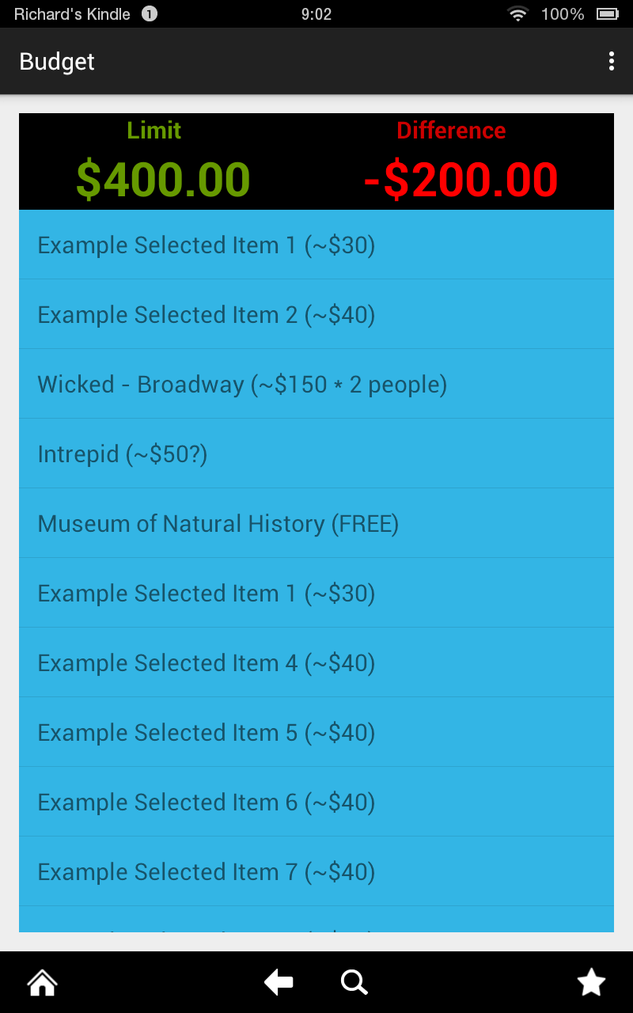

Slide 19
